Slide 1
HANGYO
Designer vs Automated

Slide 2
Compared with the mailed designer set (Mail folder)
Latest app boards (after the fixes) vs the designers' real JPEGs for the 31-store Tiruvannamalai job
Result
- 50 of 50 boards paired by shop, size and side
- 28 very close / 21 close / 1 different / 0 wrong proportions
- Every board carries the right shop name in Tamil and English
- The mailed set holds the real shop names, so these differences are real layout differences
Real mismatches found
- Portrait boards (3x5, 3x6, 4x7 ft): the name is small, in mixed case and on one line; the designer prints large UPPERCASE English on two lines (and a two-line large Tamil name on 3x6)
- Wide boards (16x3 to 26x3, 20x4 ft): the designer sets a bigger name block - 4 lines on PERUMAL STORE 20x4 - and larger logos on 26x3
- 10x3 Lakshmi Store: Tamil line is larger and English smaller than the designer's
- Side-2 6x3 boards: our English name is larger than the designer's
Why, and what it needs
- Portrait boards come from the 4 X 8 master, which matches no library element, so they use the generic rules layout (no designer example, no uppercase rule)
- Fix needs the 4 X 8 style added to the Hangyo example library (a CorelDRAW data step), not an engine change
- Name-block size on wide boards follows the nearest designer board; the designer varies it per shop
- Nothing here is a regression: these gaps existed before today's changes

Slide 3
Hangyo - at a glance
50 boards: mailed designer JPEG vs automated picture from the app
28/50
21/50
1/50
0/50
Very close
Close
Different
Wrong proportions
pixel similarity 95 % or more
88-95 % similar
under 88 % similar - layout or text differs
aspect ratio differs from the designer's by more than 5 %
How it is measured
Each automated picture is paired with the designer's JPEG of the same S.No, size and shop. Similarity = 1 - mean grey-level difference of both pictures at the same reduced size (average 0.94). It rates the whole picture, so a different shop name or a small shift barely moves it - look at the slides.
Proportions are compared from the pixel size of each picture.

Slide 4
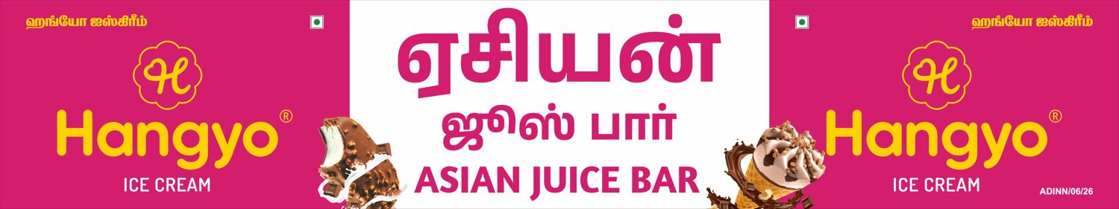

Hangyo
Asian Juice bar - 16 X 3 ft
-
CLOSE (90 %)
DESIGNER
AUTOMATED

Slide 5
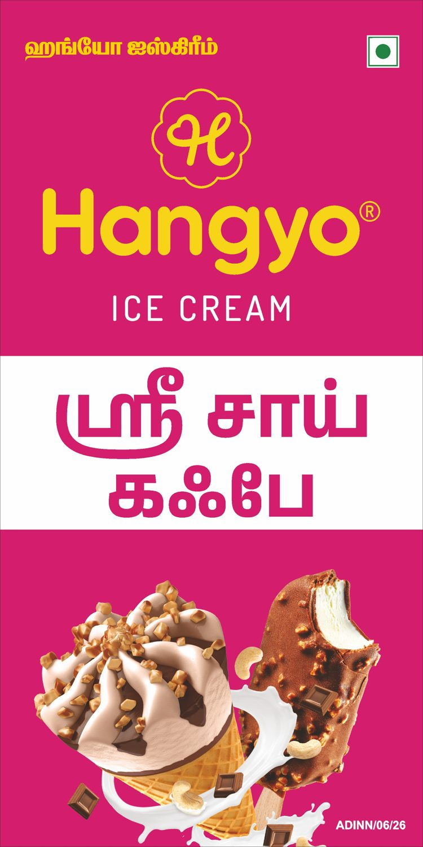
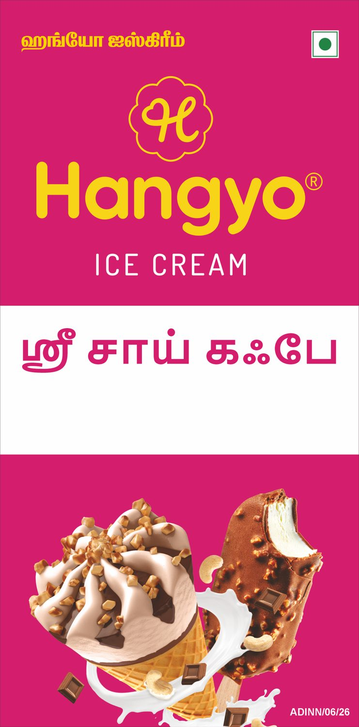
Hangyo
Sri Sai cafe (side 1) - 3 X 6 ft
-
VERY CLOSE (97 %)
DESIGNER
AUTOMATED

Slide 6
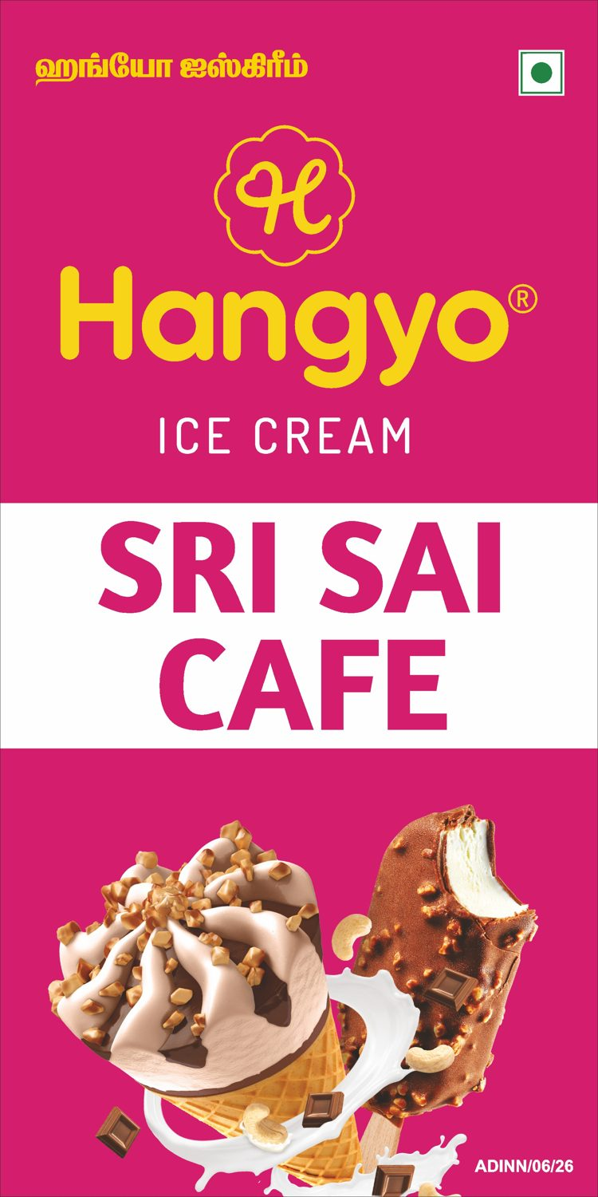
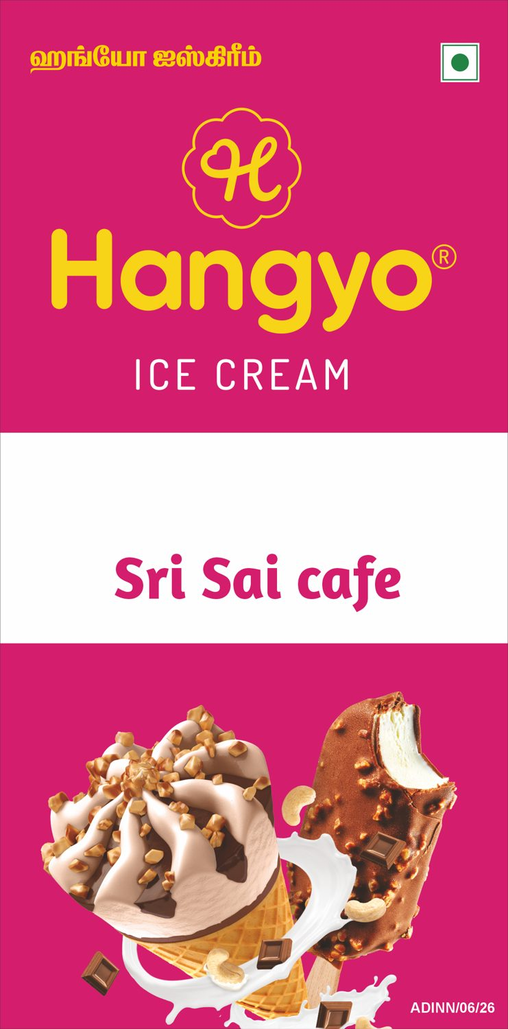
Hangyo
Sri Sai cafe (side 2) - 3 X 6 ft
-
VERY CLOSE (97 %)
DESIGNER
AUTOMATED

Slide 7
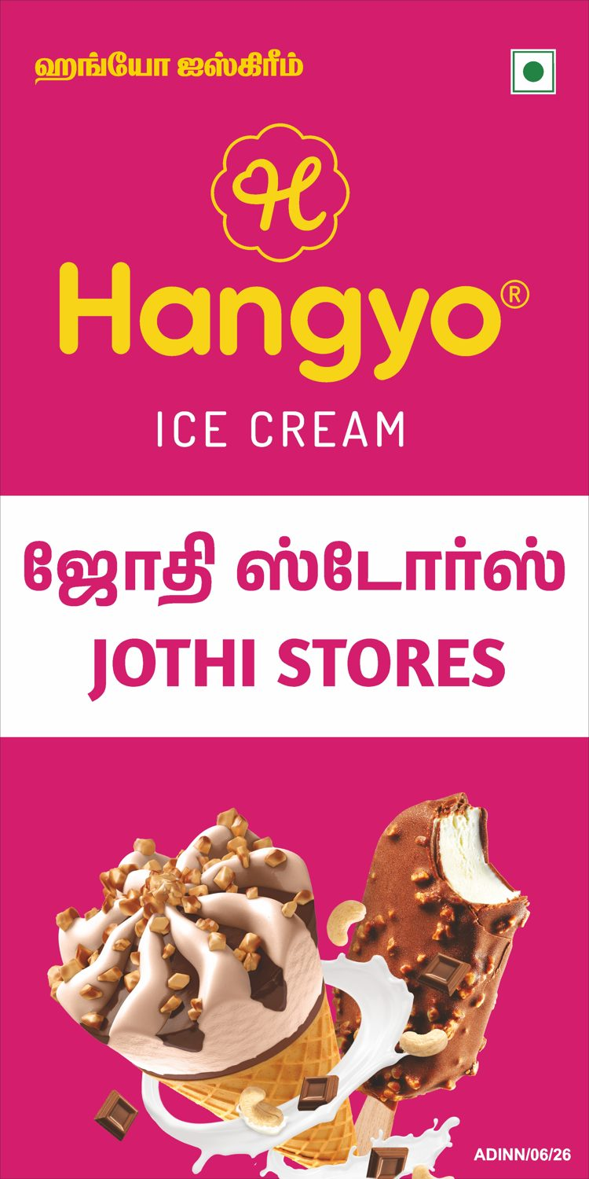
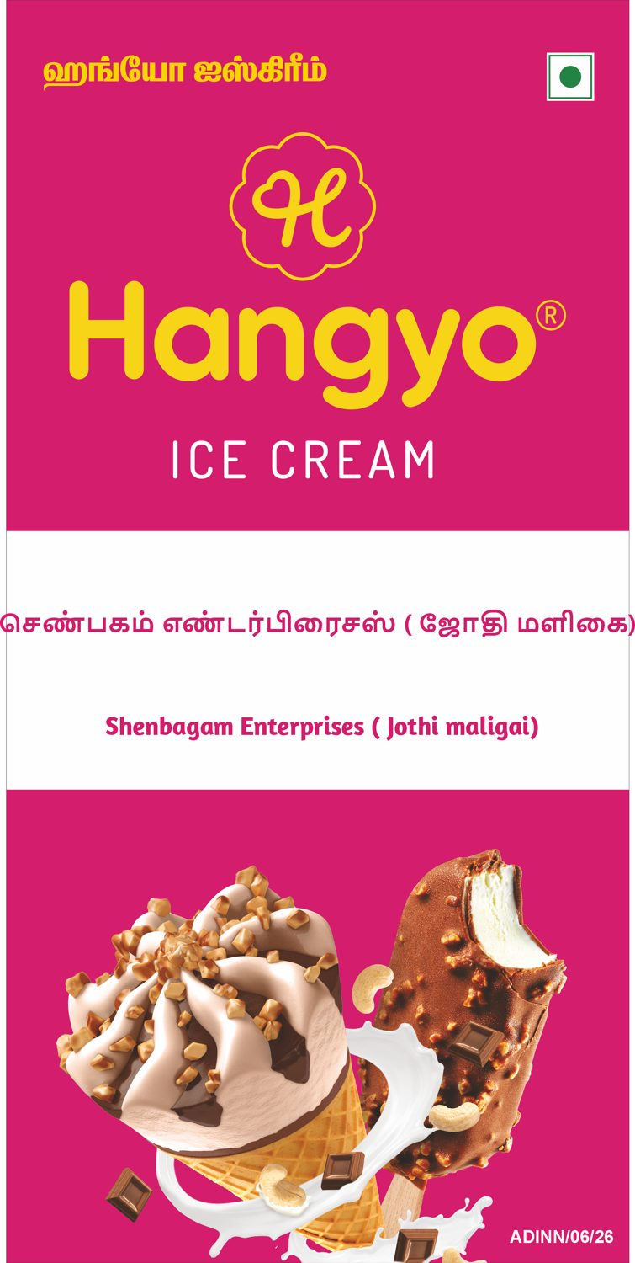
Hangyo
Shenbagam Enterprises ( Jothi maligai) - 4 X 8 ft
-
VERY CLOSE (95 %)
DESIGNER
AUTOMATED

Slide 8
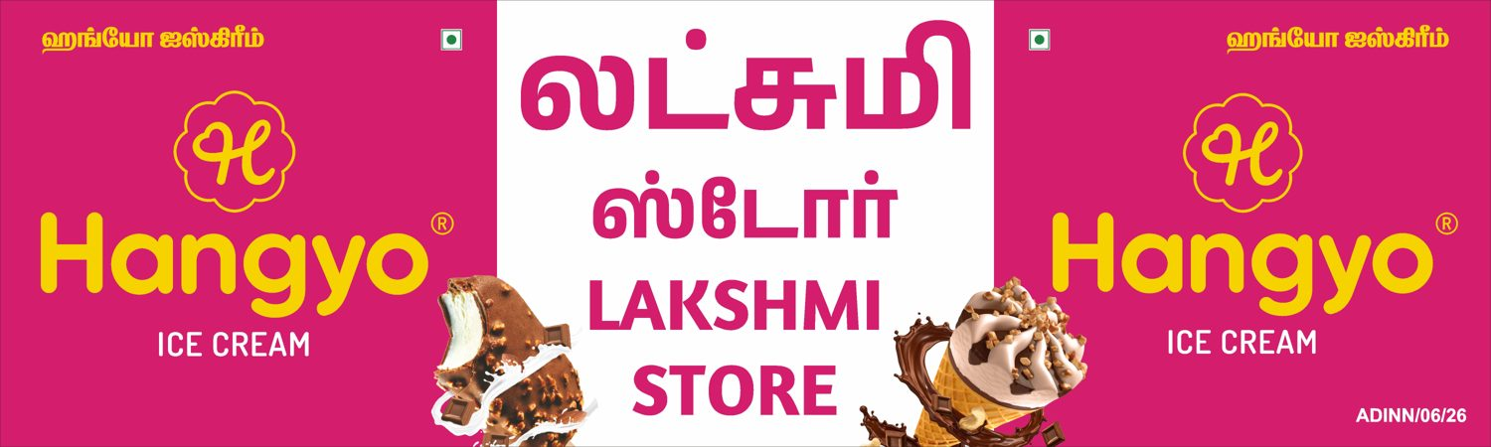
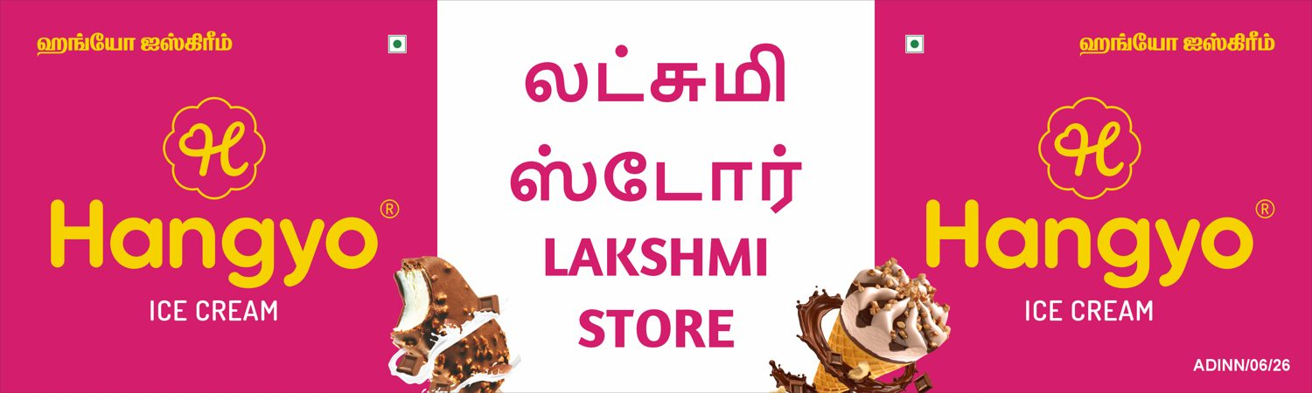
Hangyo
Lakshmi Store - 10 X 3 ft
-
CLOSE (91 %)
DESIGNER
AUTOMATED

Slide 9
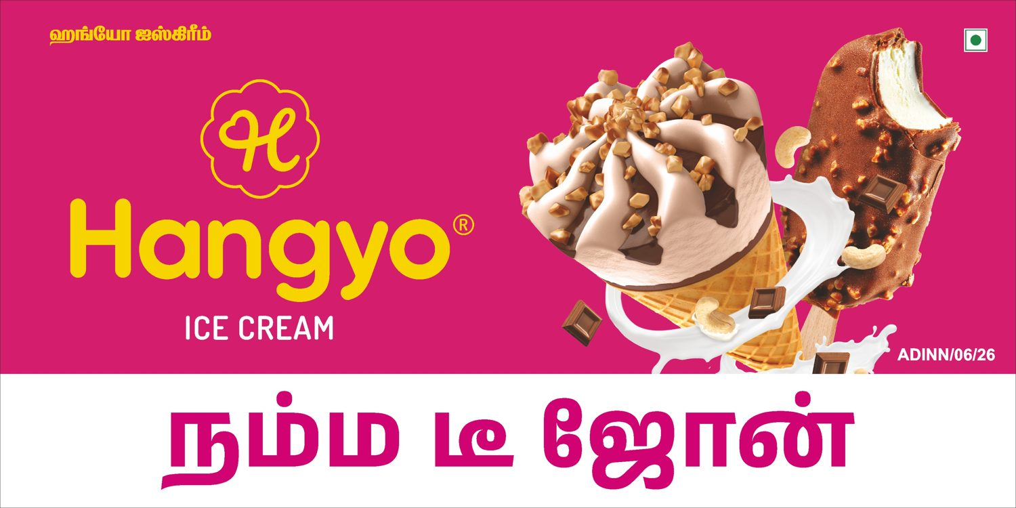
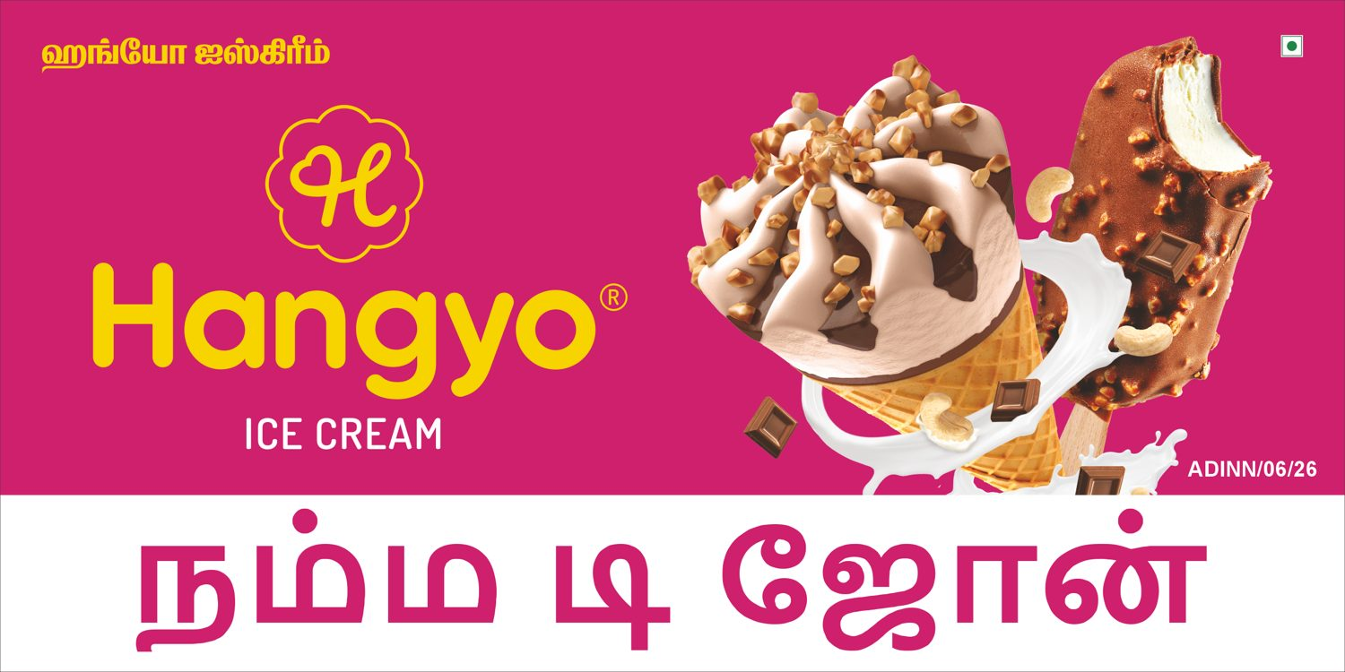
Hangyo
Namma T Zone (side 1) - 6 X 3 ft
-
VERY CLOSE (96 %)
DESIGNER
AUTOMATED

Slide 10
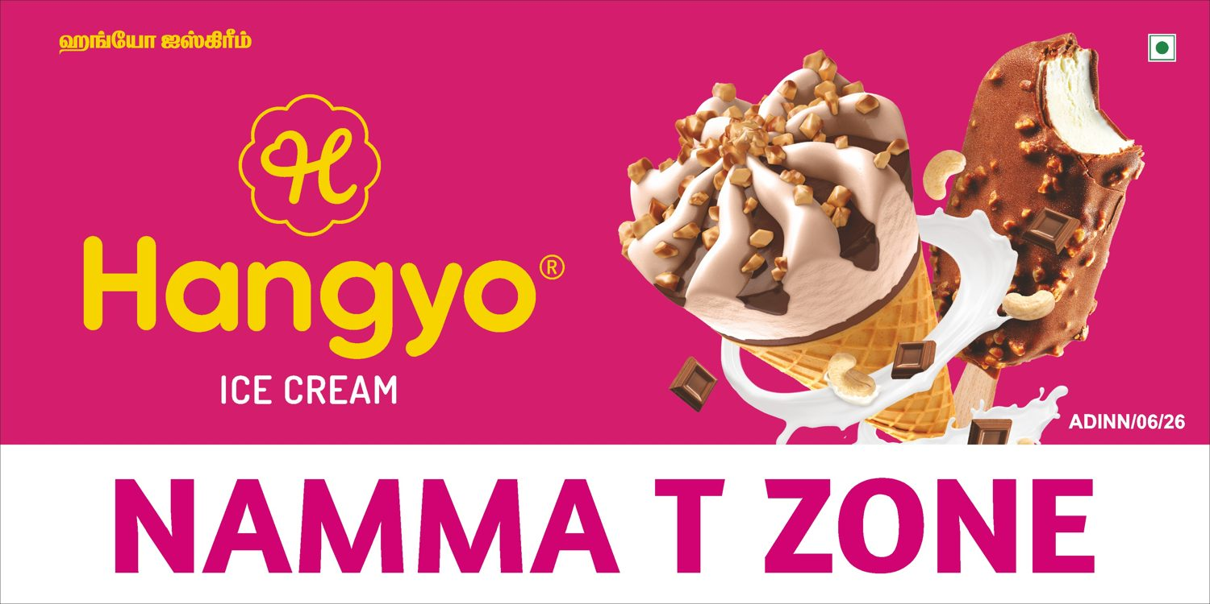
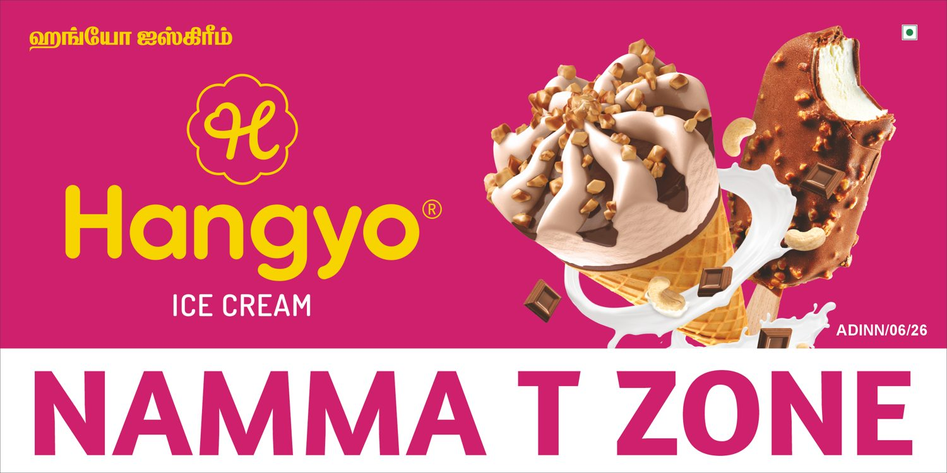
Hangyo
Namma T Zone (side 2) - 6 X 3 ft
-
CLOSE (94 %)
DESIGNER
AUTOMATED

Slide 11

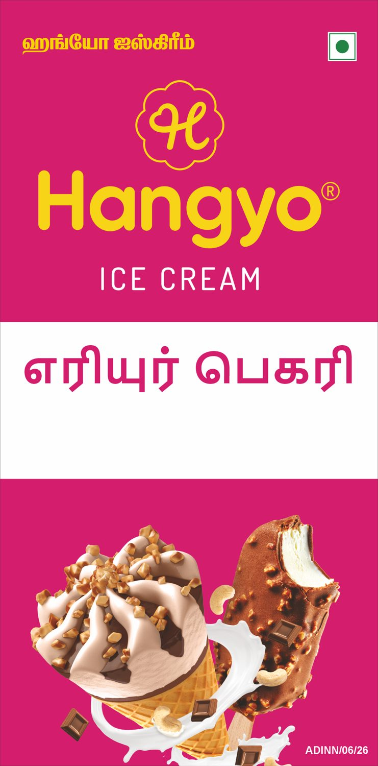
Hangyo
Eriyur Bekary (side 1) - 3 X 6 ft
-
VERY CLOSE (97 %)
DESIGNER
AUTOMATED

Slide 12
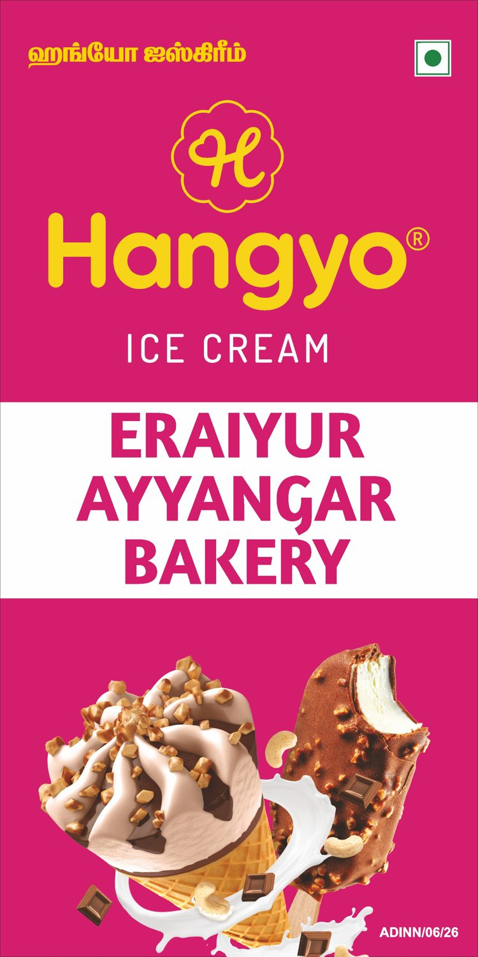
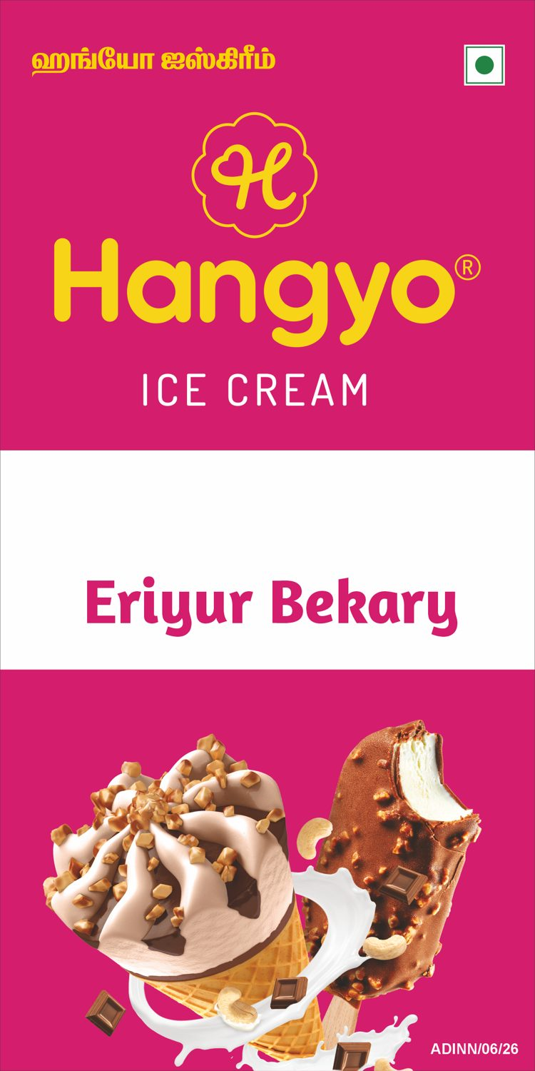
Hangyo
Eriyur Bekary (side 2) - 3 X 6 ft
-
VERY CLOSE (97 %)
DESIGNER
AUTOMATED

Slide 13


Hangyo
New Chennai bakery (side 1) - 4 X 7 ft
-
CLOSE (92 %)
DESIGNER
AUTOMATED

Slide 14
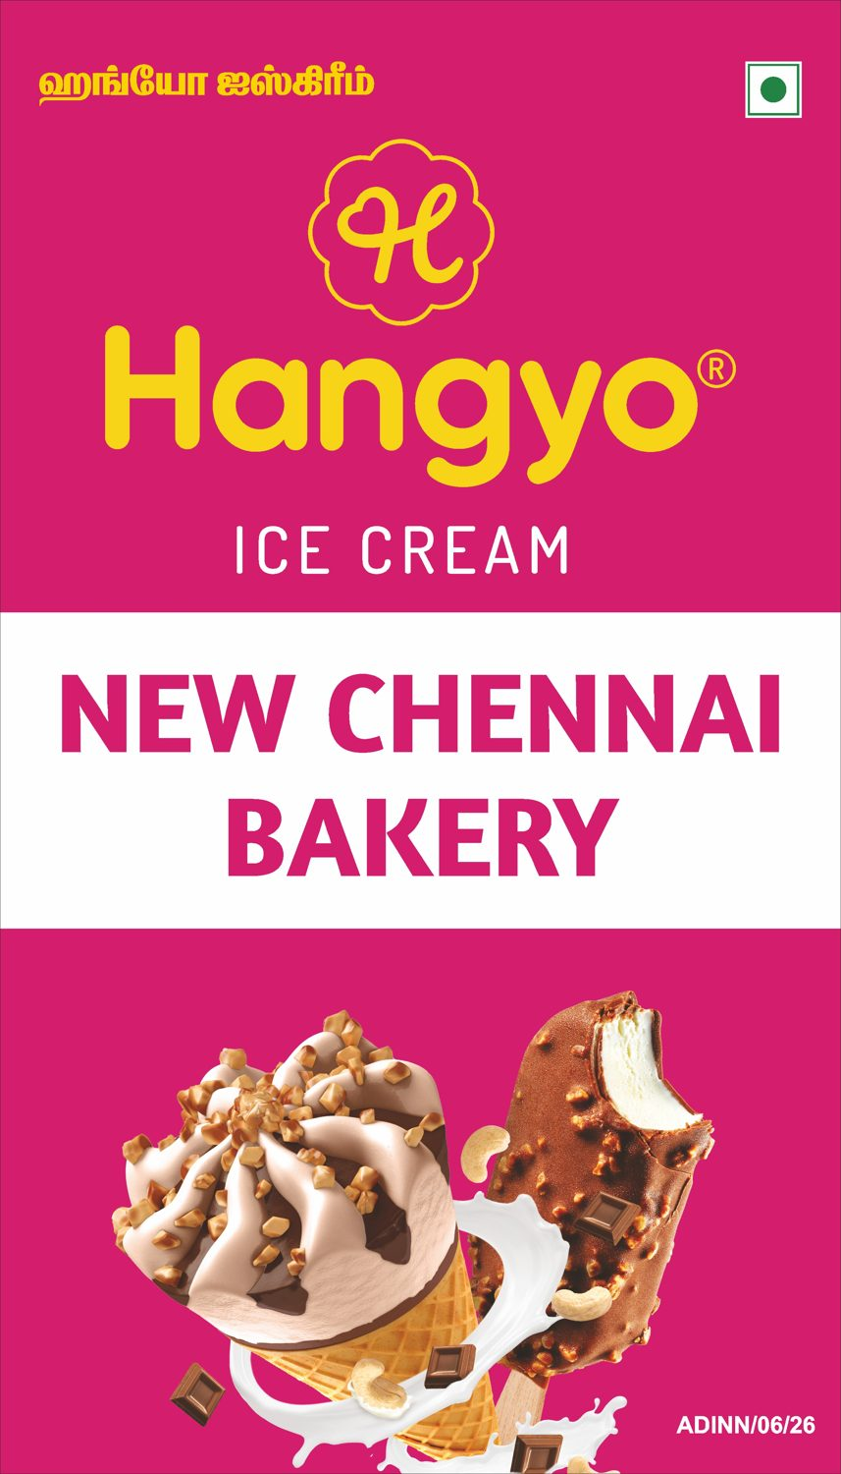
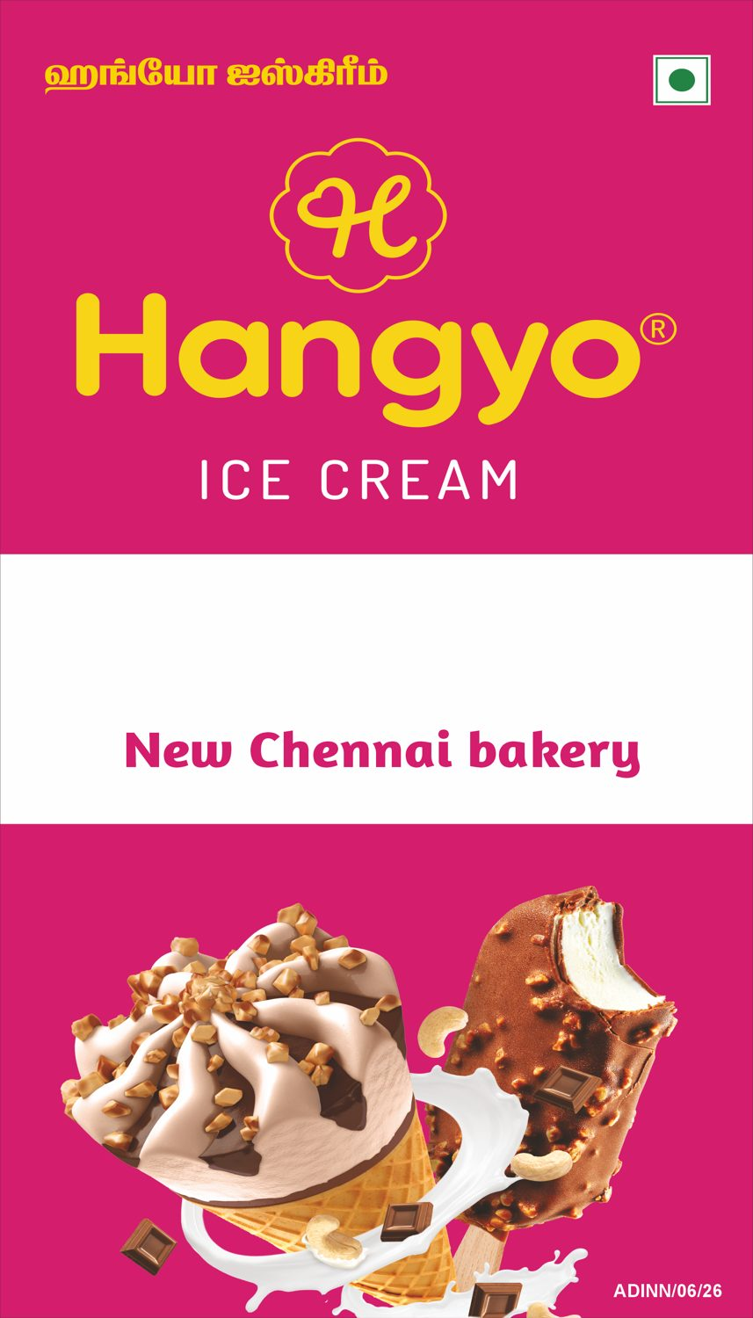
Hangyo
New Chennai bakery (side 2) - 4 X 7 ft
-
CLOSE (92 %)
DESIGNER
AUTOMATED

Slide 15
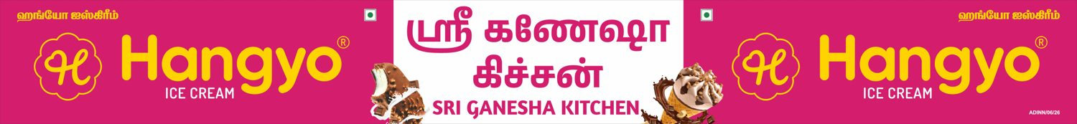
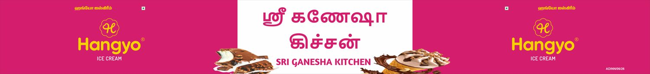
Hangyo
Sri Ganesha Kitchen - 26 X 3 ft
-
CLOSE (90 %)
DESIGNER
AUTOMATED

Slide 16
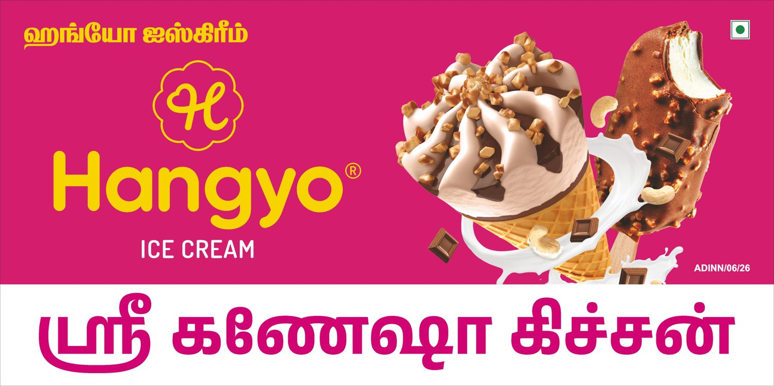
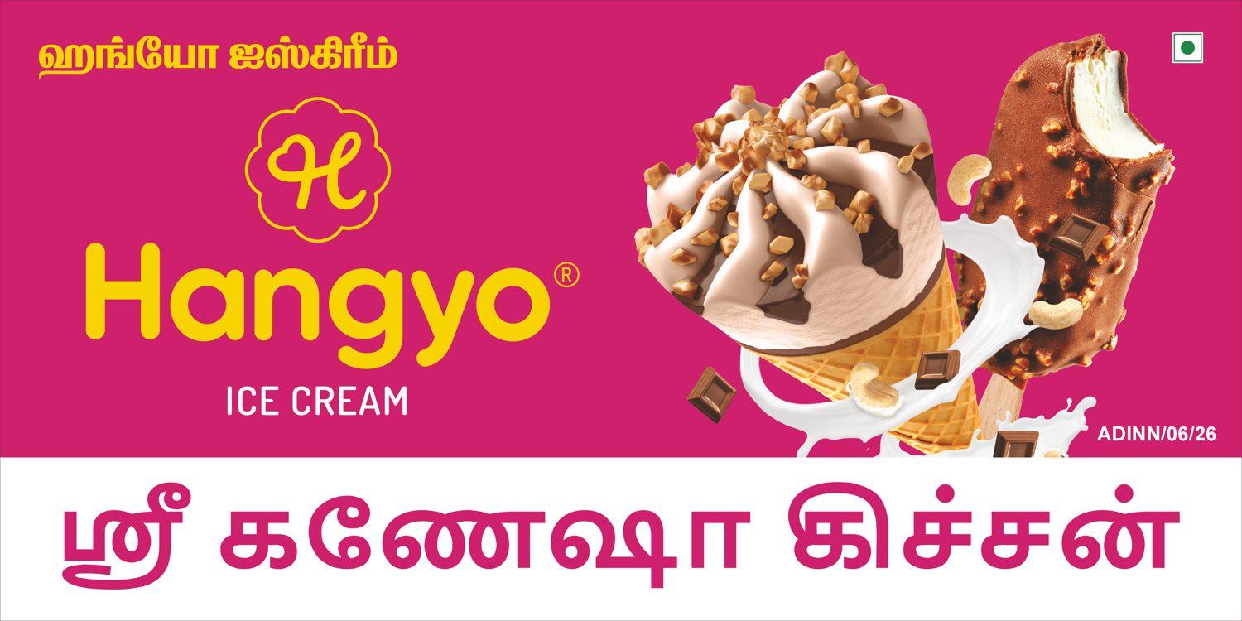
Hangyo
Sri Ganesha Kitchen (side 1) - 8 X 4 ft
-
VERY CLOSE (96 %)
DESIGNER
AUTOMATED

Slide 17
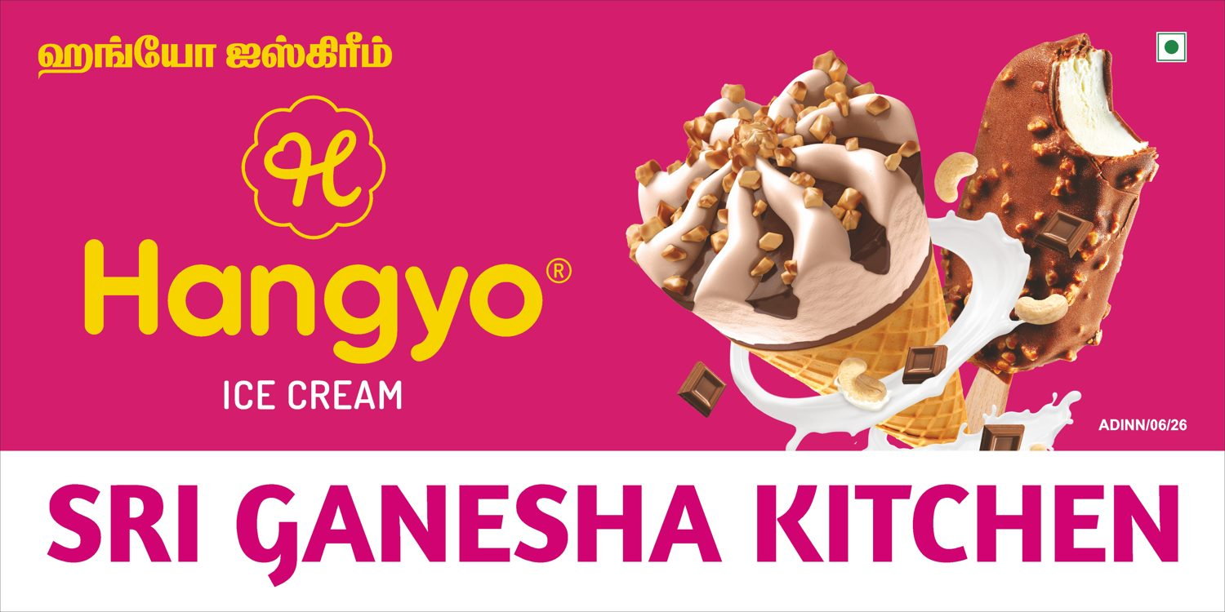
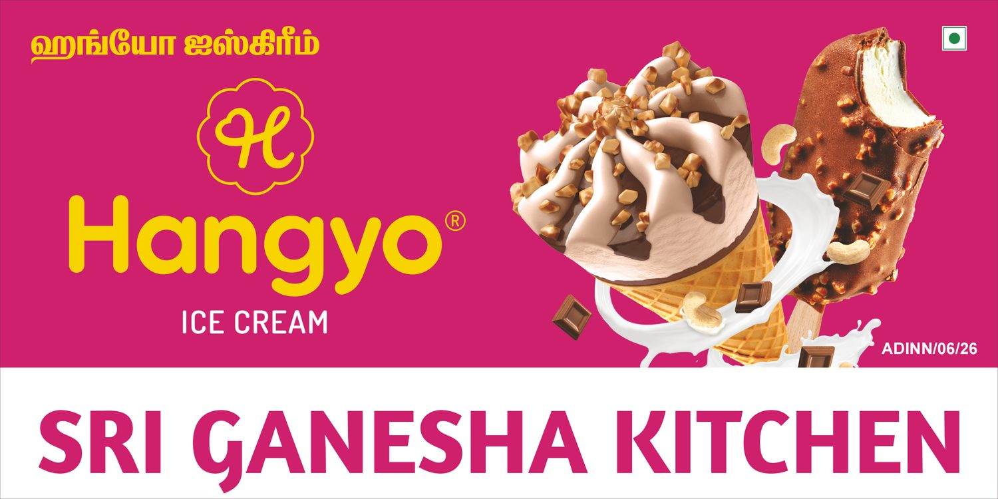
Hangyo
Sri Ganesha Kitchen (side 2) - 8 X 4 ft
-
VERY CLOSE (96 %)
DESIGNER
AUTOMATED

Slide 18

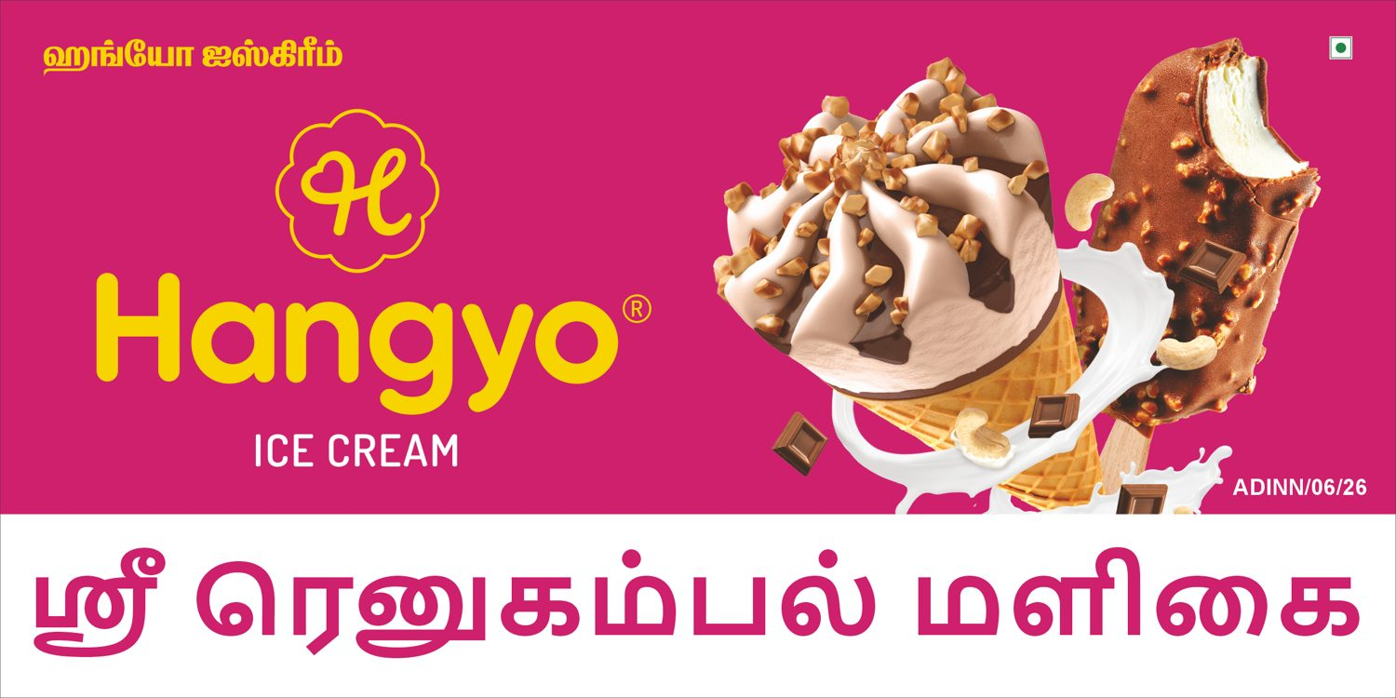
Hangyo
Sri renugambal maligai (side 1) - 6 X 3 ft
-
VERY CLOSE (96 %)
DESIGNER
AUTOMATED

Slide 19
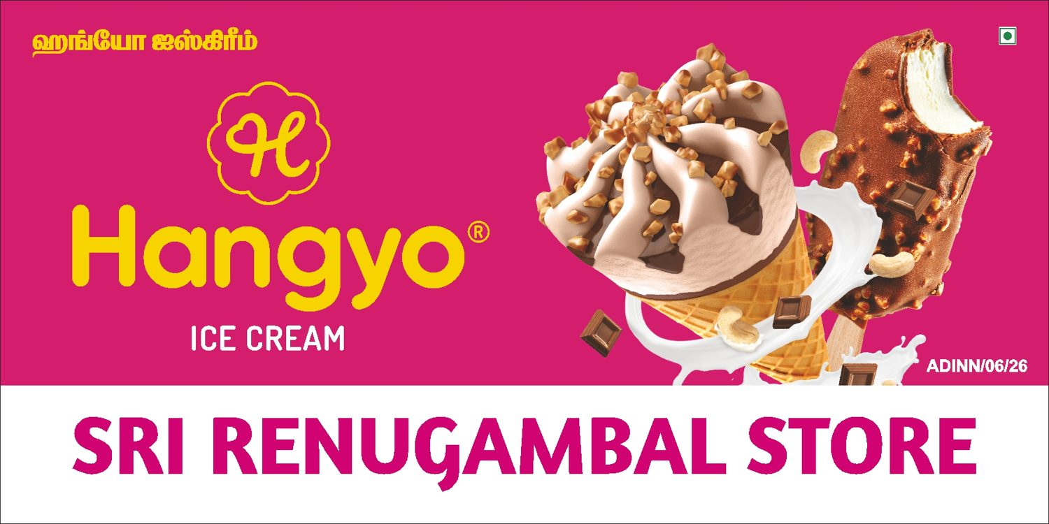
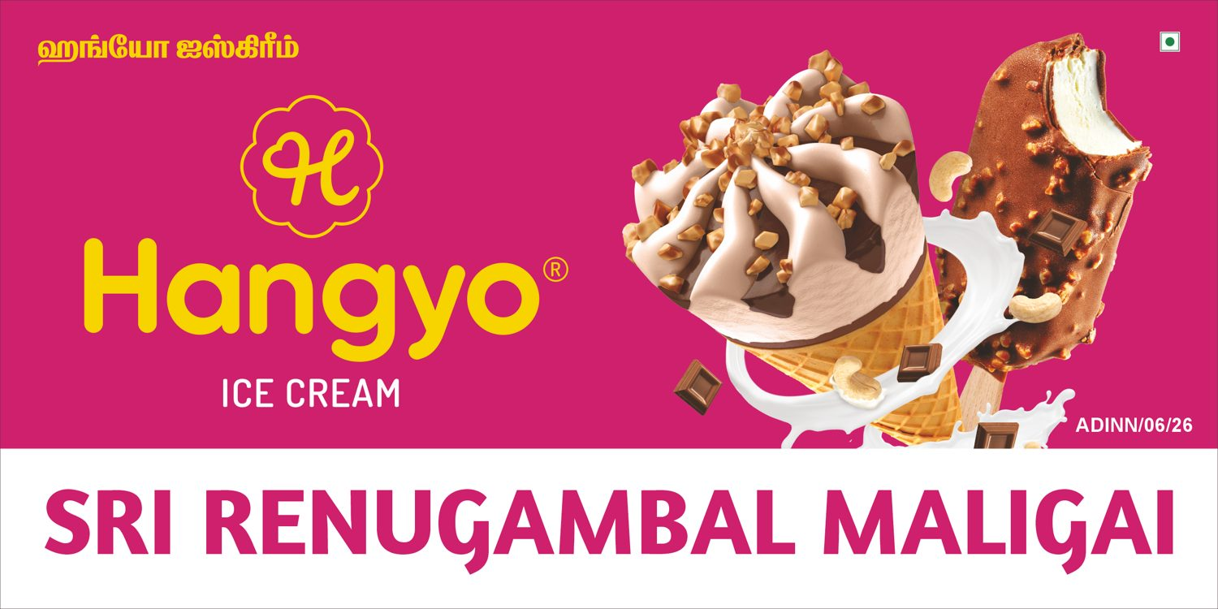
Hangyo
Sri renugambal maligai (side 2) - 6 X 3 ft
-
VERY CLOSE (96 %)
DESIGNER
AUTOMATED

Slide 20
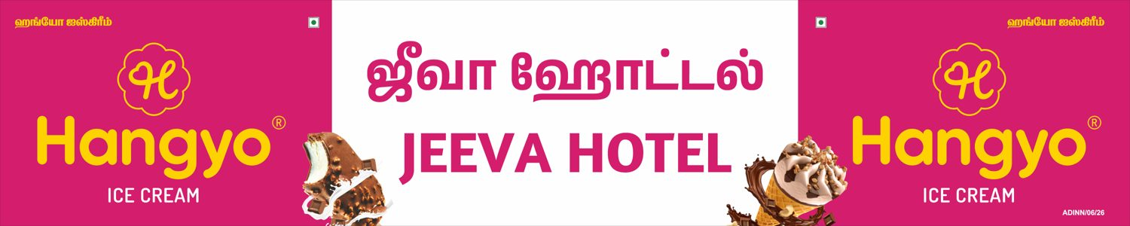

Hangyo
Jeeva hotel - 20 X 4 ft
-
CLOSE (92 %)
DESIGNER
AUTOMATED

Slide 21
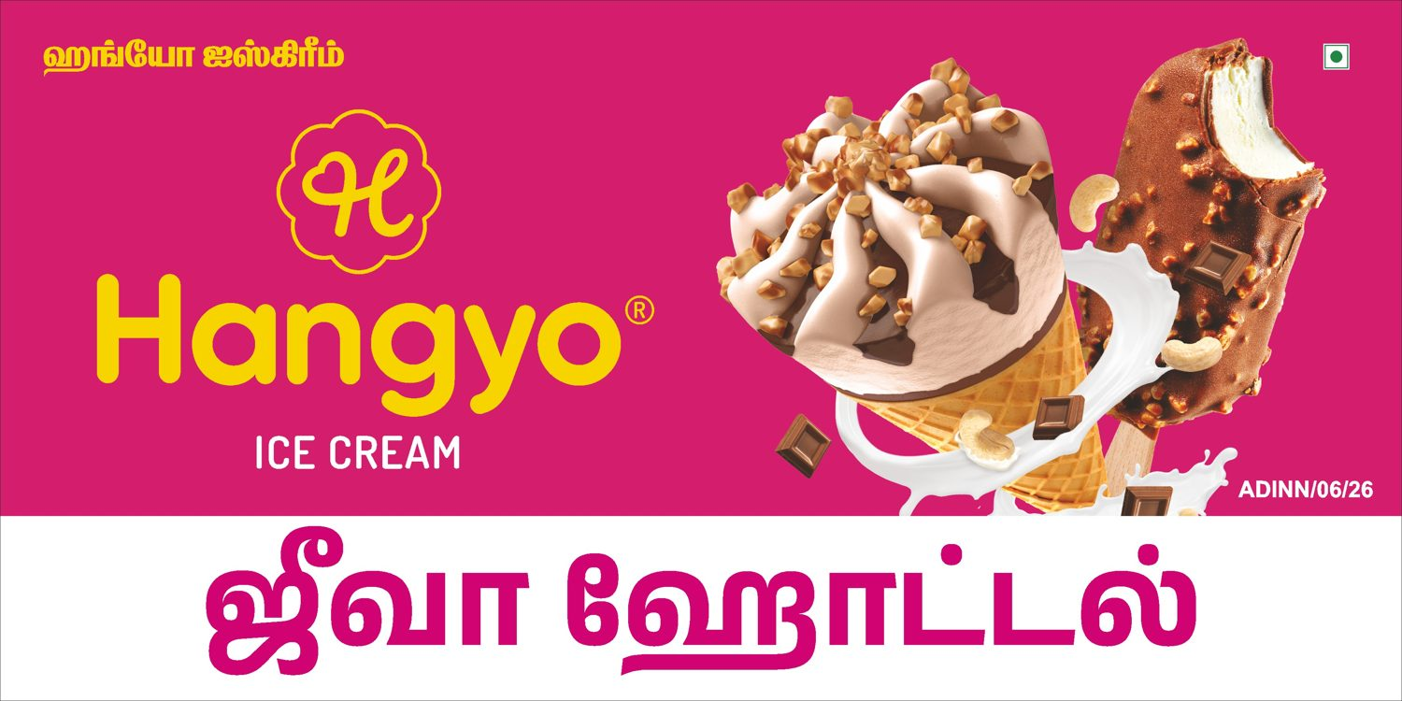
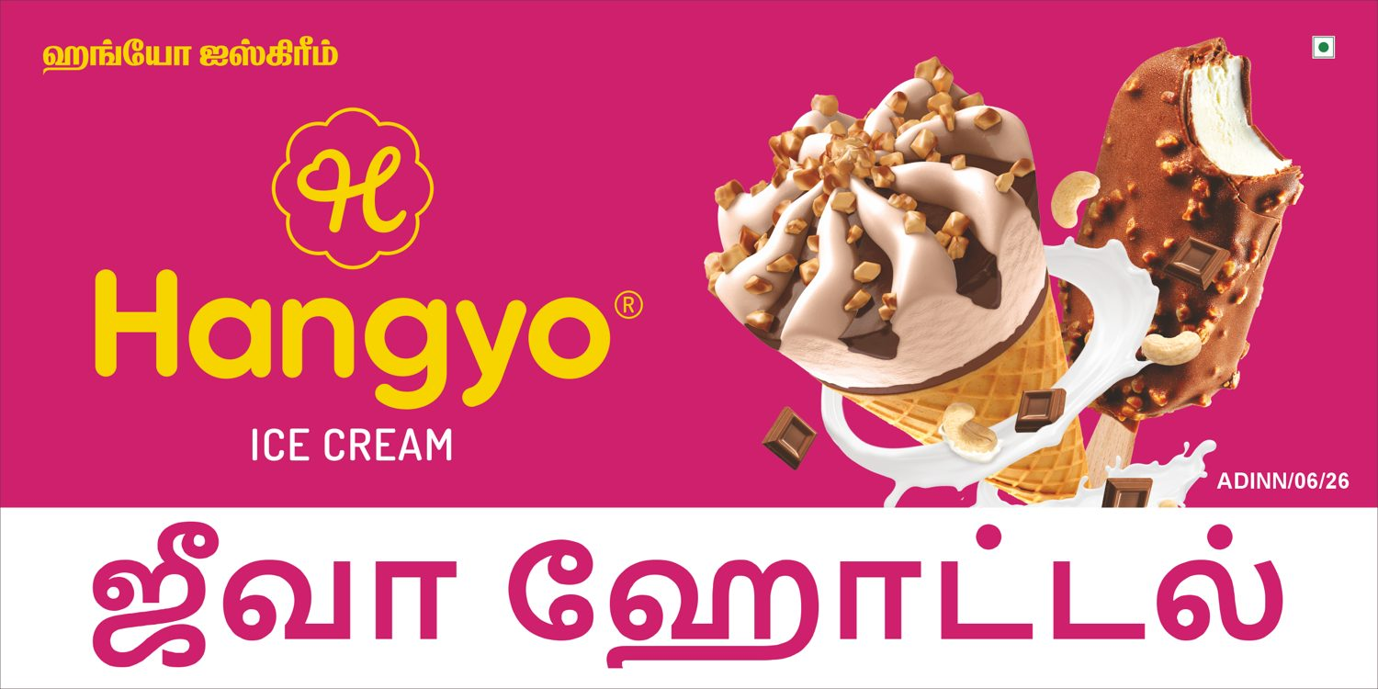
Hangyo
Jeeva hotel (side 1) - 6 X 3 ft
-
VERY CLOSE (96 %)
DESIGNER
AUTOMATED

Slide 22
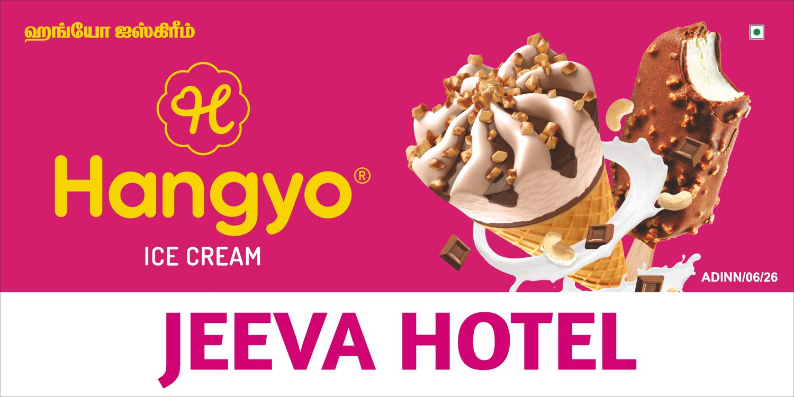
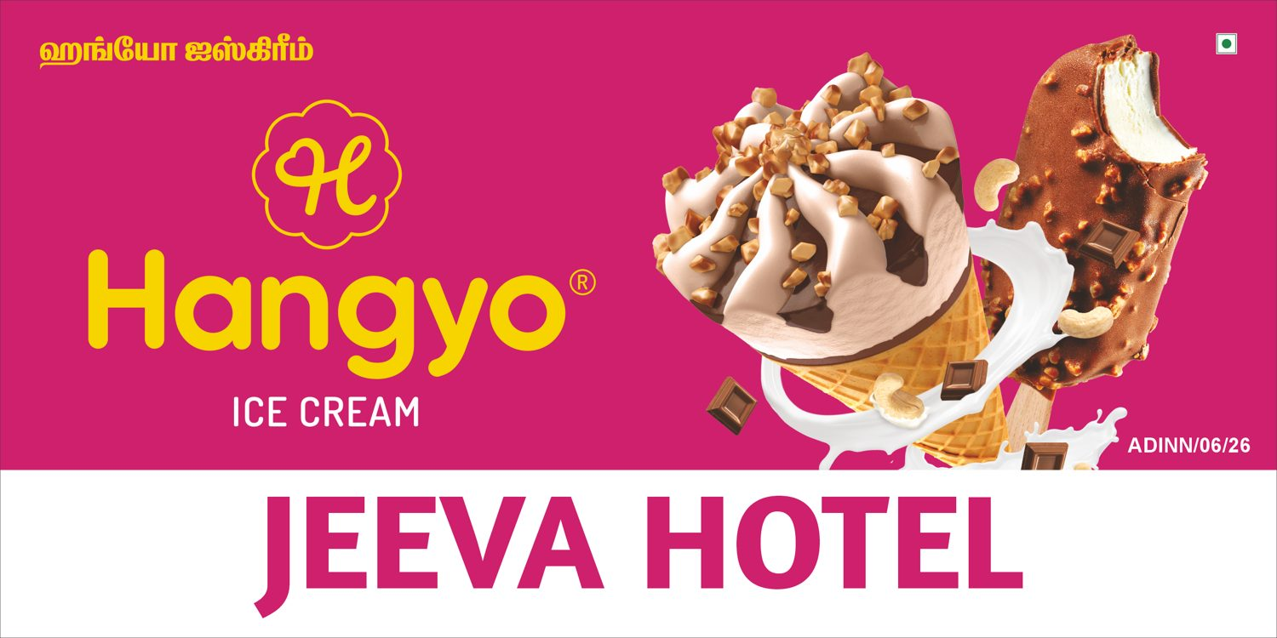
Hangyo
Jeeva hotel (side 2) - 6 X 3 ft
-
VERY CLOSE (99 %)
DESIGNER
AUTOMATED

Slide 23


Hangyo
Annamaliyar bakery And tea coffee (side 1) - 6 X 3 ft
-
VERY CLOSE (97 %)
DESIGNER
AUTOMATED

Slide 24
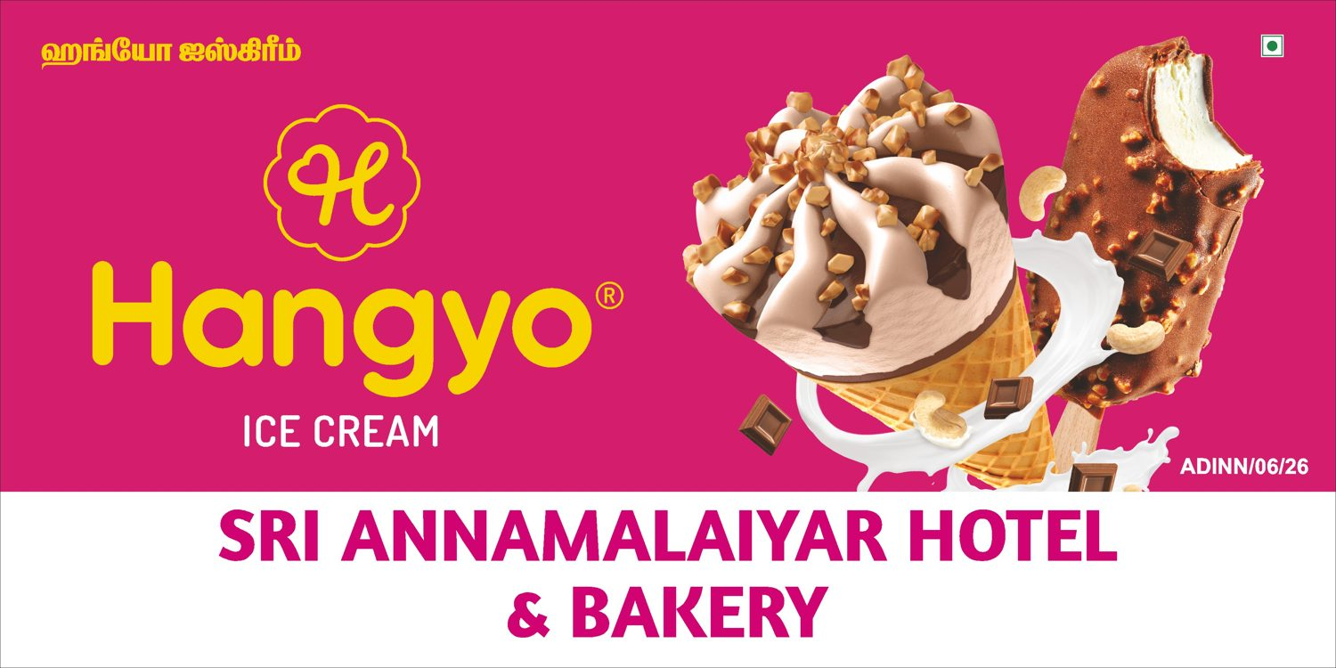
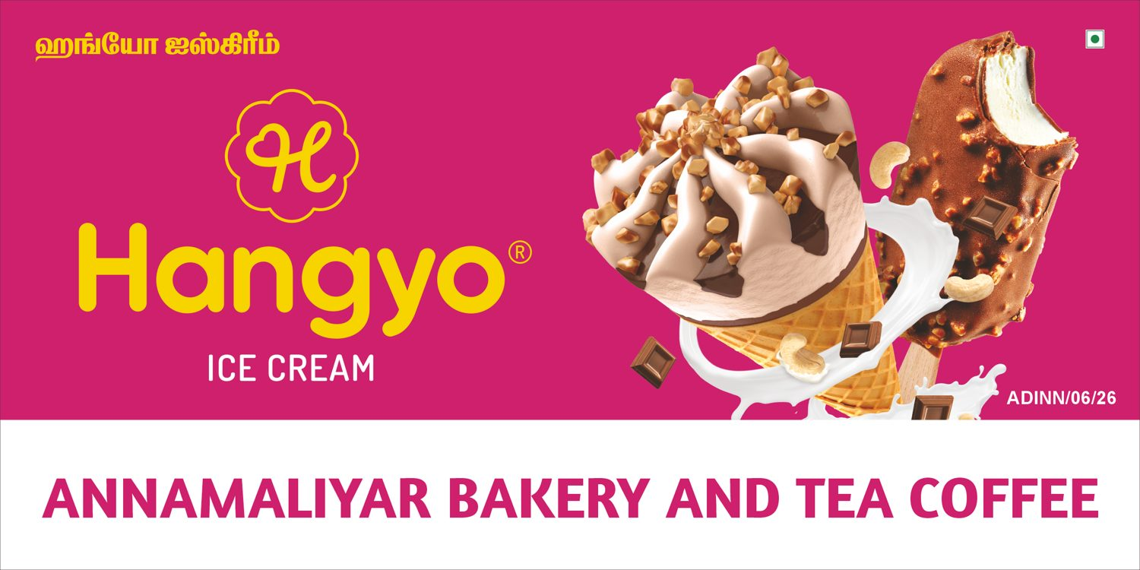
Hangyo
Annamaliyar bakery And tea coffee (side 2) - 6 X 3 ft
-
VERY CLOSE (95 %)
DESIGNER
AUTOMATED

Slide 25


Hangyo
Saravanan maligai store (side 1) - 6 X 3 ft
-
VERY CLOSE (96 %)
DESIGNER
AUTOMATED

Slide 26
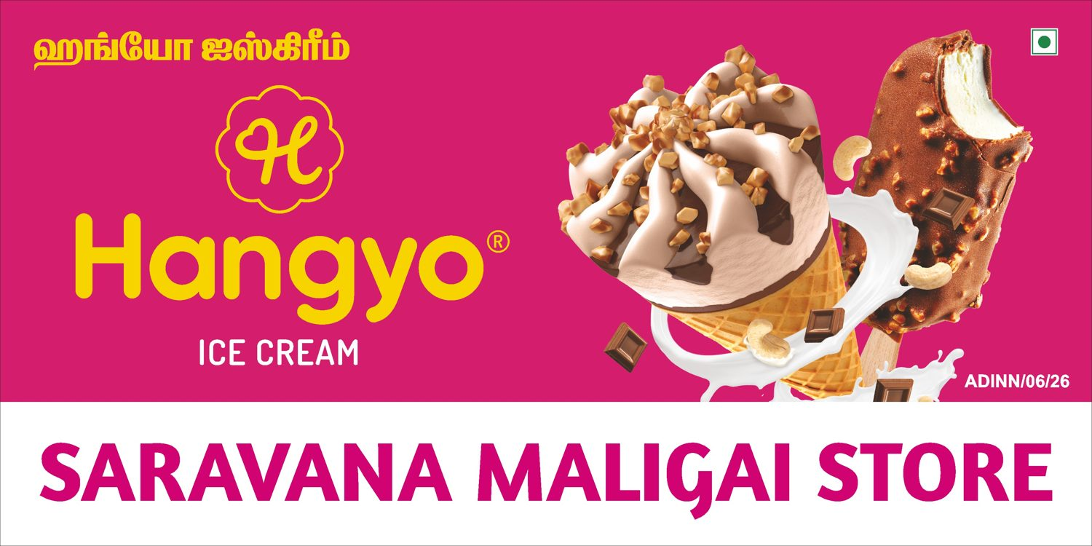
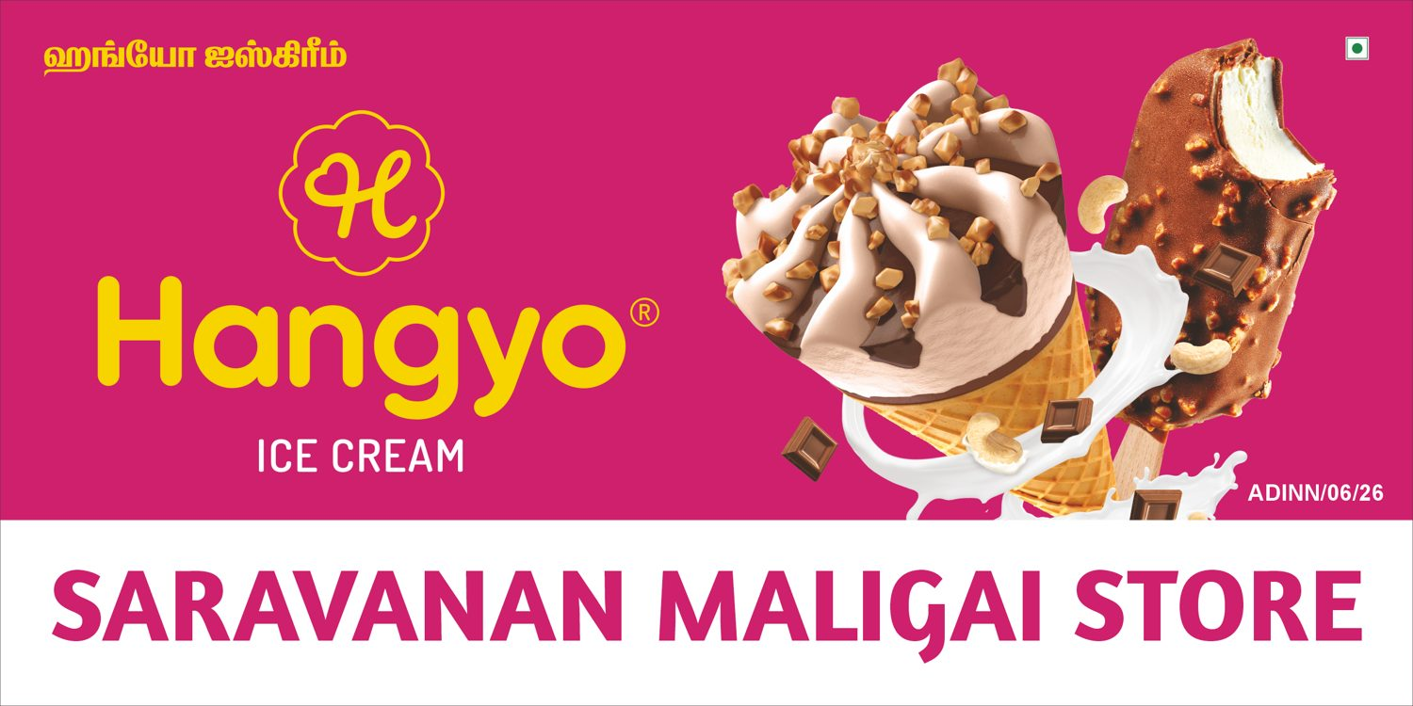
Hangyo
Saravanan maligai store (side 2) - 6 X 3 ft
-
VERY CLOSE (96 %)
DESIGNER
AUTOMATED

Slide 27
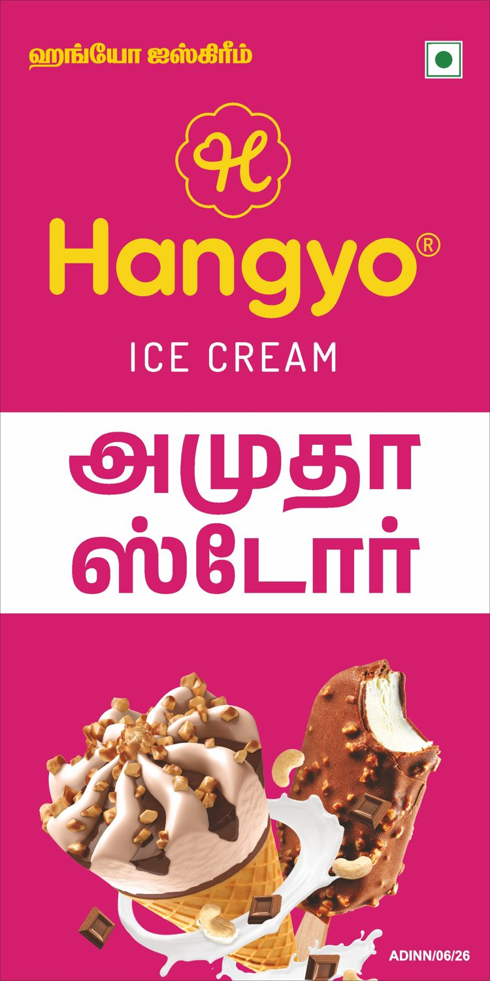
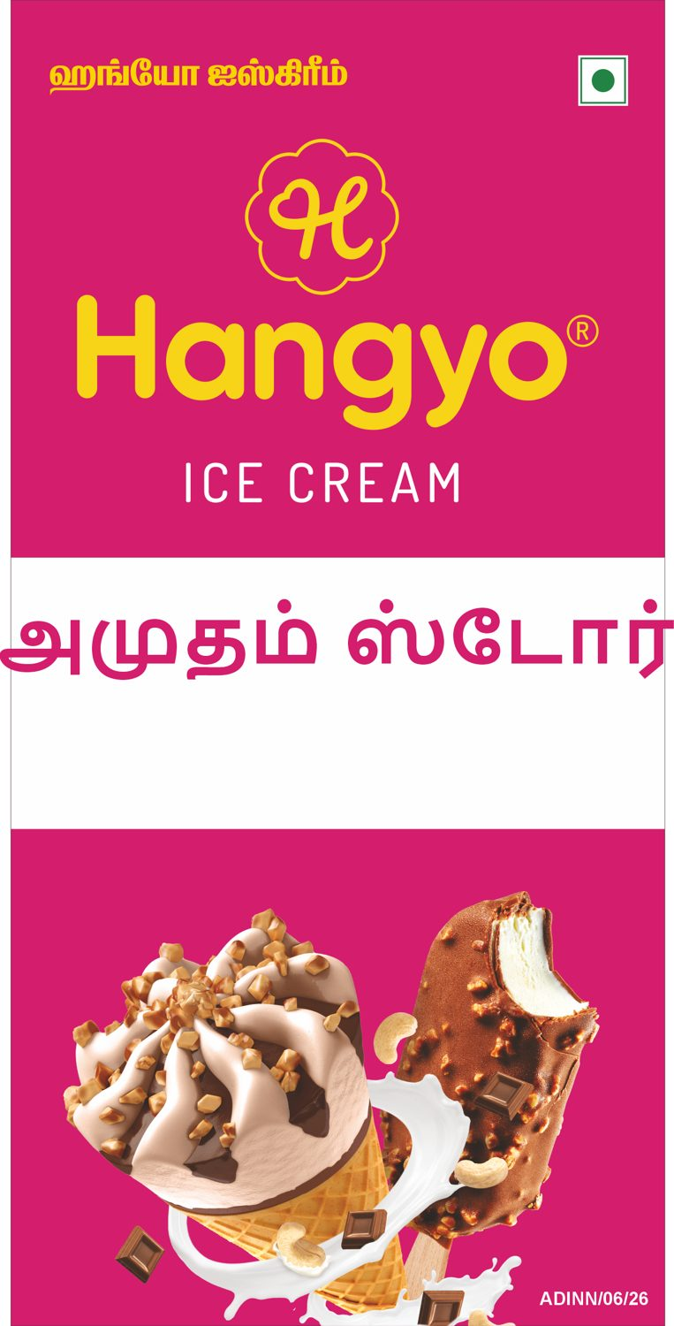
Hangyo
Amutham Store (side 1) - 3 X 6 ft
-
CLOSE (92 %)
DESIGNER
AUTOMATED

Slide 28
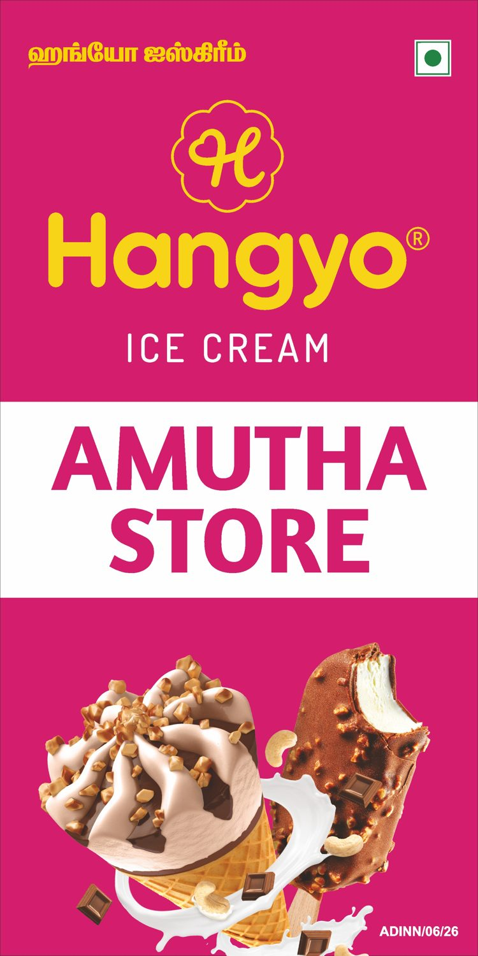
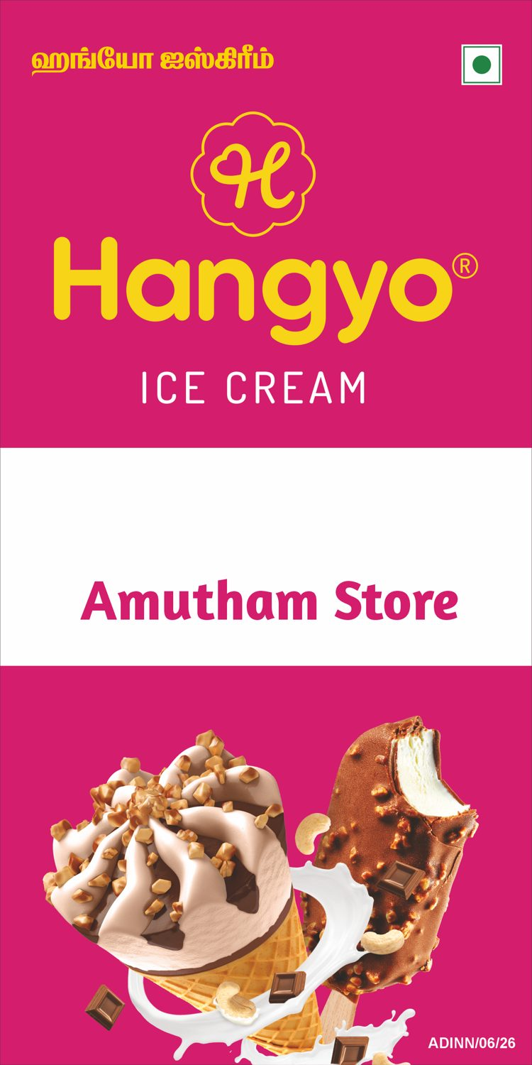
Hangyo
Amutham Store (side 2) - 3 X 6 ft
-
VERY CLOSE (96 %)
DESIGNER
AUTOMATED

Slide 29
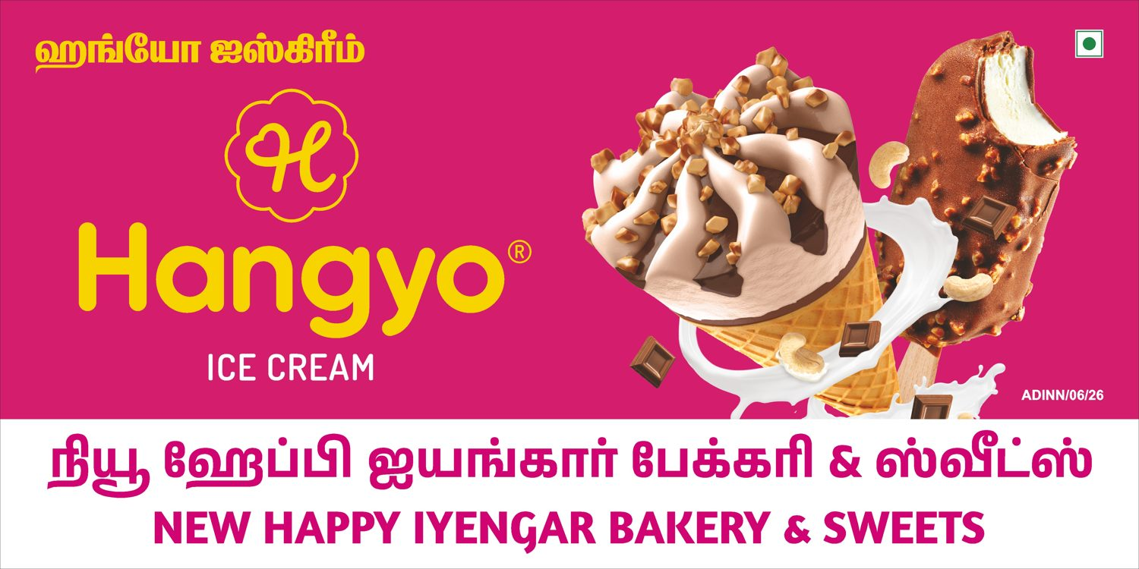

Hangyo
New Sri happy Iyengar bakery - 8 X 4 ft
-
VERY CLOSE (96 %)
DESIGNER
AUTOMATED

Slide 30

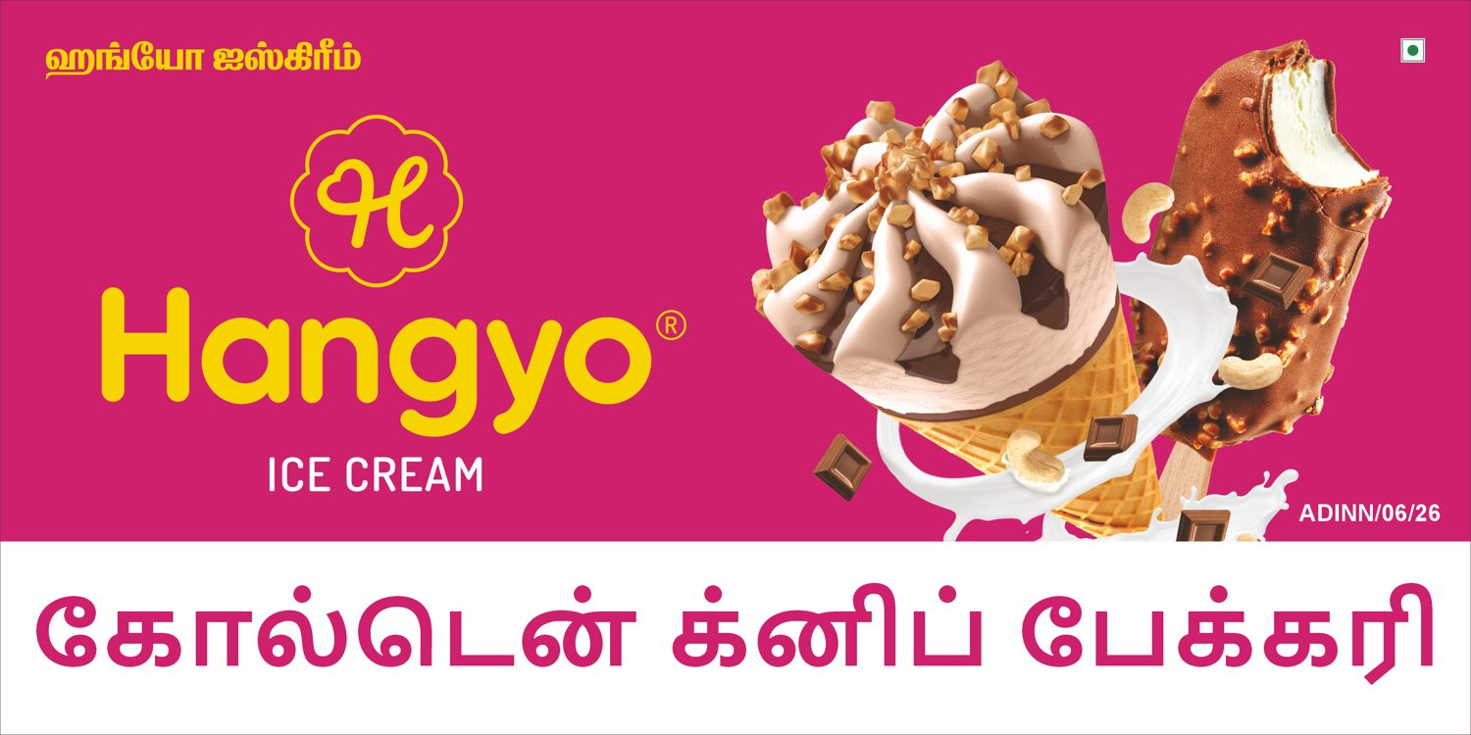
Hangyo
Golden Knife Bakery (side 1) - 6 X 3 ft
-
VERY CLOSE (96 %)
DESIGNER
AUTOMATED

Slide 31


Hangyo
Golden Knife Bakery (side 2) - 6 X 3 ft
-
VERY CLOSE (97 %)
DESIGNER
AUTOMATED

Slide 32


Hangyo
Shanvi fancy store (side 1) - 3 X 5 ft
-
CLOSE (92 %)
DESIGNER
AUTOMATED

Slide 33
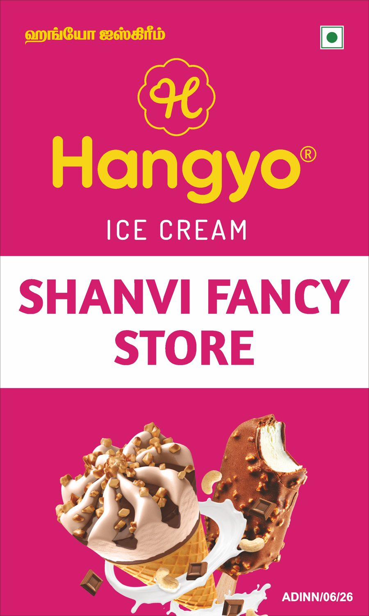
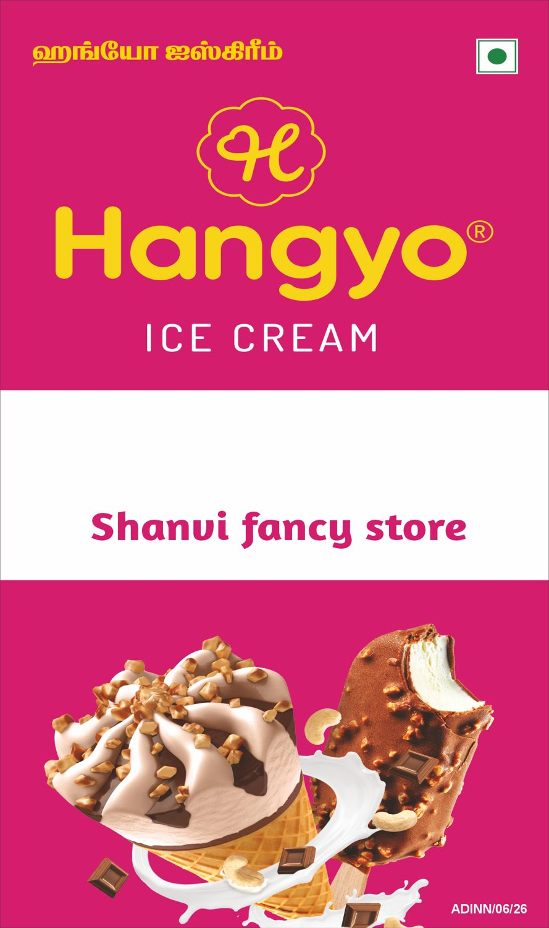
Hangyo
Shanvi fancy store (side 2) - 3 X 5 ft
-
CLOSE (91 %)
DESIGNER
AUTOMATED

Slide 34
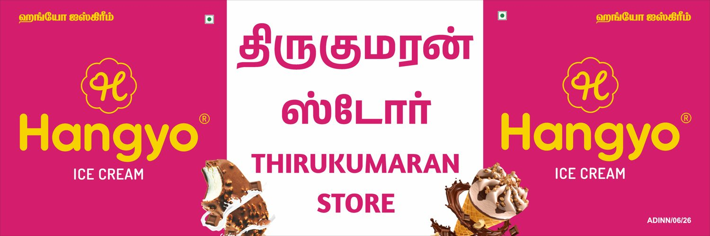
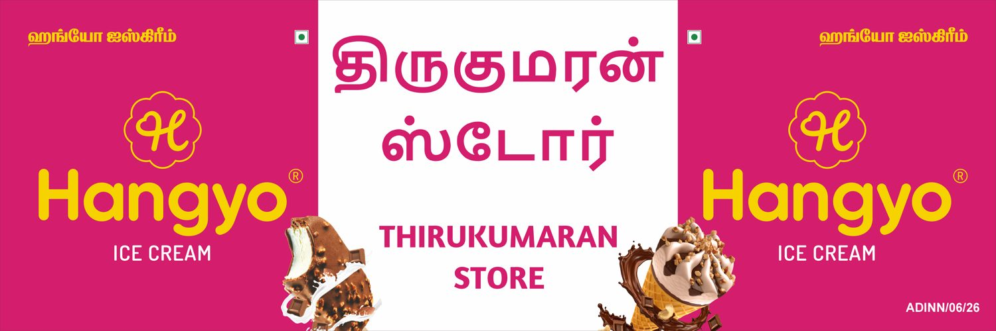
Hangyo
Thirukumaran store - 12 X 4 ft
-
CLOSE (92 %)
DESIGNER
AUTOMATED

Slide 35
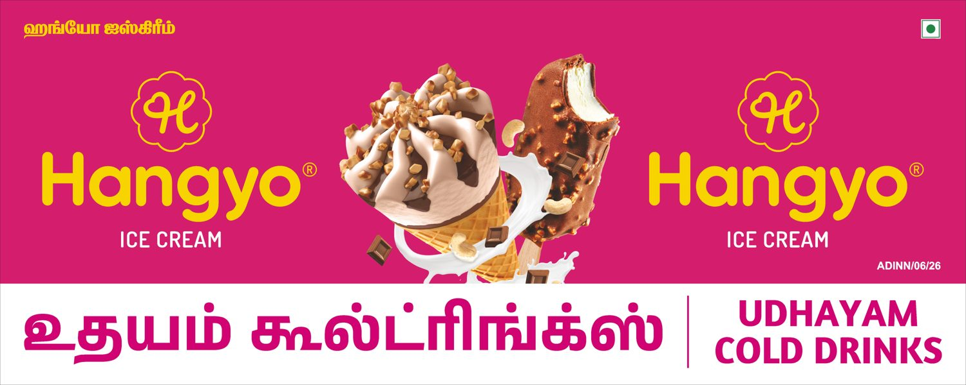
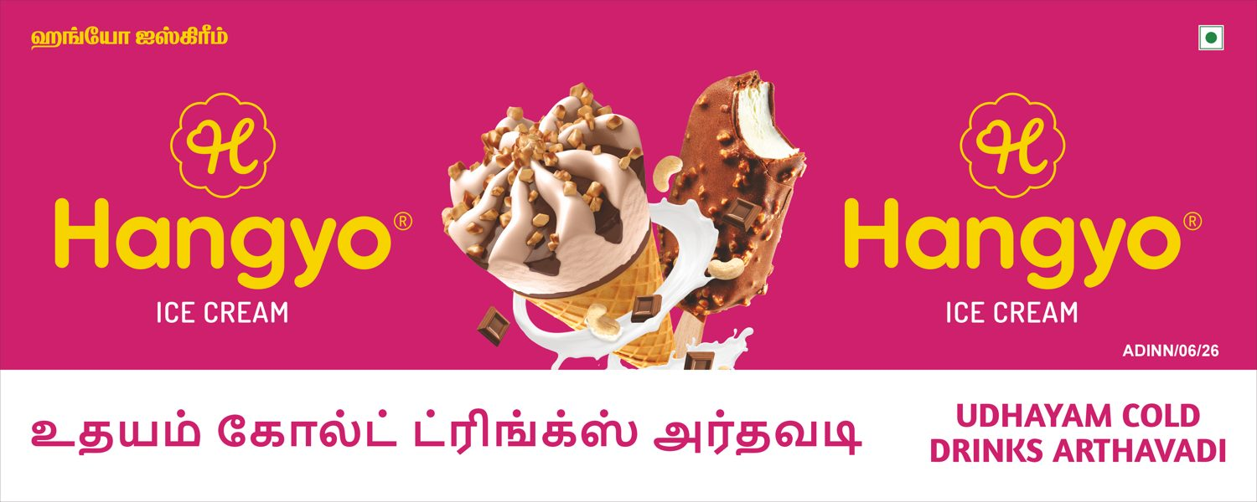
Hangyo
Udhayam cold drinks arthavadi - 10 X 4 ft
-
VERY CLOSE (96 %)
DESIGNER
AUTOMATED

Slide 36
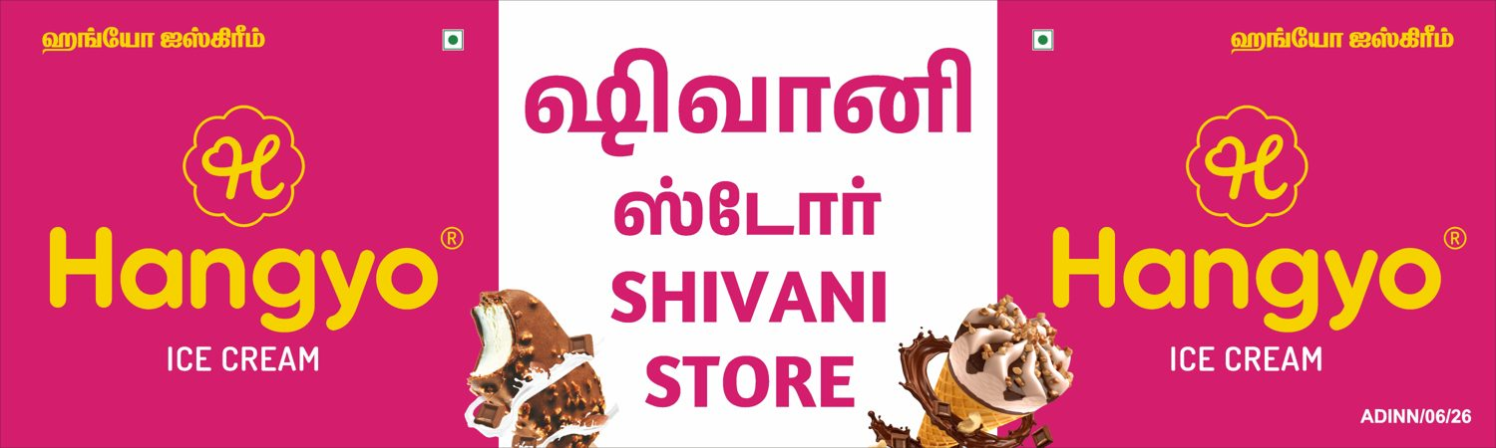
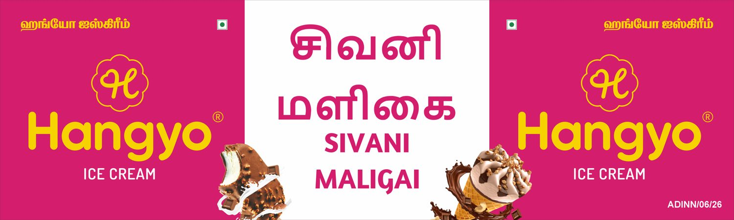
Hangyo
Sivani Maligai - 10 X 3 ft
-
CLOSE (92 %)
DESIGNER
AUTOMATED

Slide 37


Hangyo
Sri thanga Vilas soda factory - 8 X 3 ft
-
VERY CLOSE (97 %)
DESIGNER
AUTOMATED

Slide 38


Hangyo
Paramasivam store - 8 X 3 ft
-
VERY CLOSE (97 %)
DESIGNER
AUTOMATED

Slide 39


Hangyo
Bengaluru bakery - 20 X 3 ft
-
CLOSE (90 %)
DESIGNER
AUTOMATED

Slide 40


Hangyo
Guru tea stall - 10 X 3 ft
-
CLOSE (94 %)
DESIGNER
AUTOMATED

Slide 41


Hangyo
PERUMAL STORE - 20 X 4 ft
-
DIFFERENT (86 %)
DESIGNER
AUTOMATED

Slide 42


Hangyo
PERUMAL STORE (side 1) - 6 X 3 ft
-
VERY CLOSE (95 %)
DESIGNER
AUTOMATED

Slide 43


Hangyo
PERUMAL STORE (side 2) - 6 X 3 ft
-
VERY CLOSE (97 %)
DESIGNER
AUTOMATED

Slide 44


Hangyo
Karthikeyan store - 10 X 3 ft
-
CLOSE (94 %)
DESIGNER
AUTOMATED

Slide 45


Hangyo
Karthikeyan store - 20 X 3 ft
-
CLOSE (90 %)
DESIGNER
AUTOMATED

Slide 46


Hangyo
Om guru sweets & bakery - 20 X 3 ft
-
CLOSE (90 %)
DESIGNER
AUTOMATED

Slide 47


Hangyo
Om guru sweets & bakery (side 1) - 3 X 6 ft
-
VERY CLOSE (96 %)
DESIGNER
AUTOMATED

Slide 48


Hangyo
Om guru sweets & bakery (side 2) - 3 X 6 ft
-
VERY CLOSE (96 %)
DESIGNER
AUTOMATED

Slide 49


Hangyo
Jairam maligai - 20 X 4 ft
-
CLOSE (89 %)
DESIGNER
AUTOMATED

Slide 50


Hangyo
Sekar store - 10 X 3 ft
-
CLOSE (94 %)
DESIGNER
AUTOMATED

Slide 51


Hangyo
Hotel dhanalakshmi Vilas - 15 X 3 ft
-
CLOSE (91 %)
DESIGNER
AUTOMATED

Slide 52


Hangyo
Arulmoli maligai & bakery - 10 X 3 ft
-
VERY CLOSE (96 %)
DESIGNER
AUTOMATED

Slide 53


Hangyo
Kanish Cool Drink's - 10 X 3 ft
-
CLOSE (94 %)
DESIGNER
AUTOMATED

